Slide 1
The greedy method
Suppose that a problem can be solved by a sequence of decisions. The greedy method has that each decision is locally optimal. These locally optimal solutions will finally add up to a globally optimal solution.
Only a few optimization problems can be solved by the greedy method.

Slide 2
What makes a greedy algorithm?
Feasible
Has to satisfy the problem’s constraints
Locally Optimal
The greedy part
Has to make the best local choice among all feasible choices available on that step
If this local choice results in a global optimum then the problem has optimal substructure
Irrevocable
Once a choice is made it can’t be un-done on subsequent steps of the algorithm
Simple examples:
Playing chess by making best move without lookahead
Giving fewest number of coins as change
Simple and appealing, but don’t always give the best solution

Slide 3
CONTROL ABSTRACTION
Algorithm Greedy (a, n)
// a(1 : n) contains the ‘n’ inputs
{
solution := ; // initialize the solution to empty
for i:=1 to n do
{
x := select (a);
feasible (solution, x) then
solution := Union (Solution, x);
}
return solution;
}

Slide 4
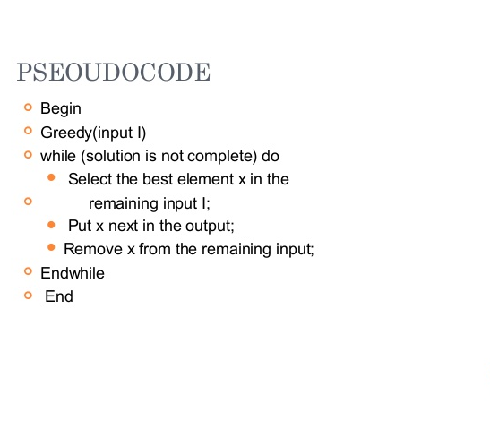

Slide 5
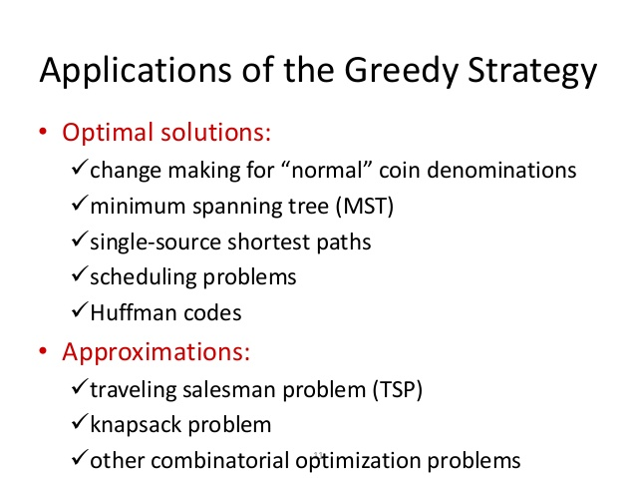

Slide 6
KNAPSACK PROBLEM Let us apply the greedy method to solve the knapsack problem. We are given ‘n’ objects and a knapsack. The object ‘i’ has a weight wi and the knapsack has a capacity ‘m’. If a fraction xi, 0 < xi < 1 of object i is placed into the knapsack then a profit of pi xi is earned. The objective is to fill the knapsack that maximizes the total profit earned.

Slide 7
The knapsack problem problem statement
n objects, each with a weight w_{i} > 0
a profit p_{i} > 0
capacity of knapsack: M
Maximize
Subject to
0 ≤ x_{i} ≤ 1, 1 ≤ i ≤ n

Slide 8
Algorithm
If the objects are already been sorted into non-increasing order of p[i] / w[i] then the algorithm given below obtains solutions corresponding to this strategy.
Algorithm GreedyKnapsack (m, n)
// P[1 : n] and w[1 : n] contain the profits and weights respectively of
// Objects ordered so that p[i] / w[i]> p[i + 1] / w[i + 1].
// m is the knapsack size and x[1: n] is the solution vector.
{
for i := 1 to n do x[i] := 0.0 // initialize x
U := m;
for i := 1 to n do
{
if (w(i) > U) then break;
x [i] := 1.0; U := U – w[i];
}
if (i < n) then x[i] := U / w[i];
}

Slide 9
Running time: The objects are to be sorted into non-decreasing order of pi / wi ratio. But if we disregard the time to initially sort the objects, the algorithm requires only O(n) time.
Example: Consider the following instance of the knapsack problem: n = 3, m = 20, (p1, p2, p3) = (25, 24, 15) and (w1, w2, w3) = (18, 15, 10).

Slide 10
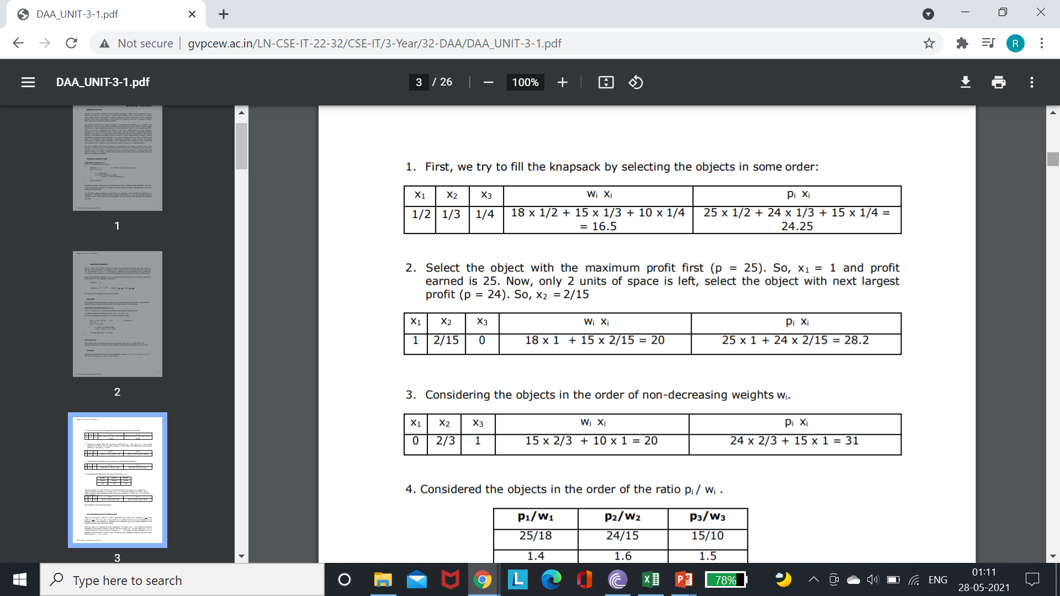

Slide 11
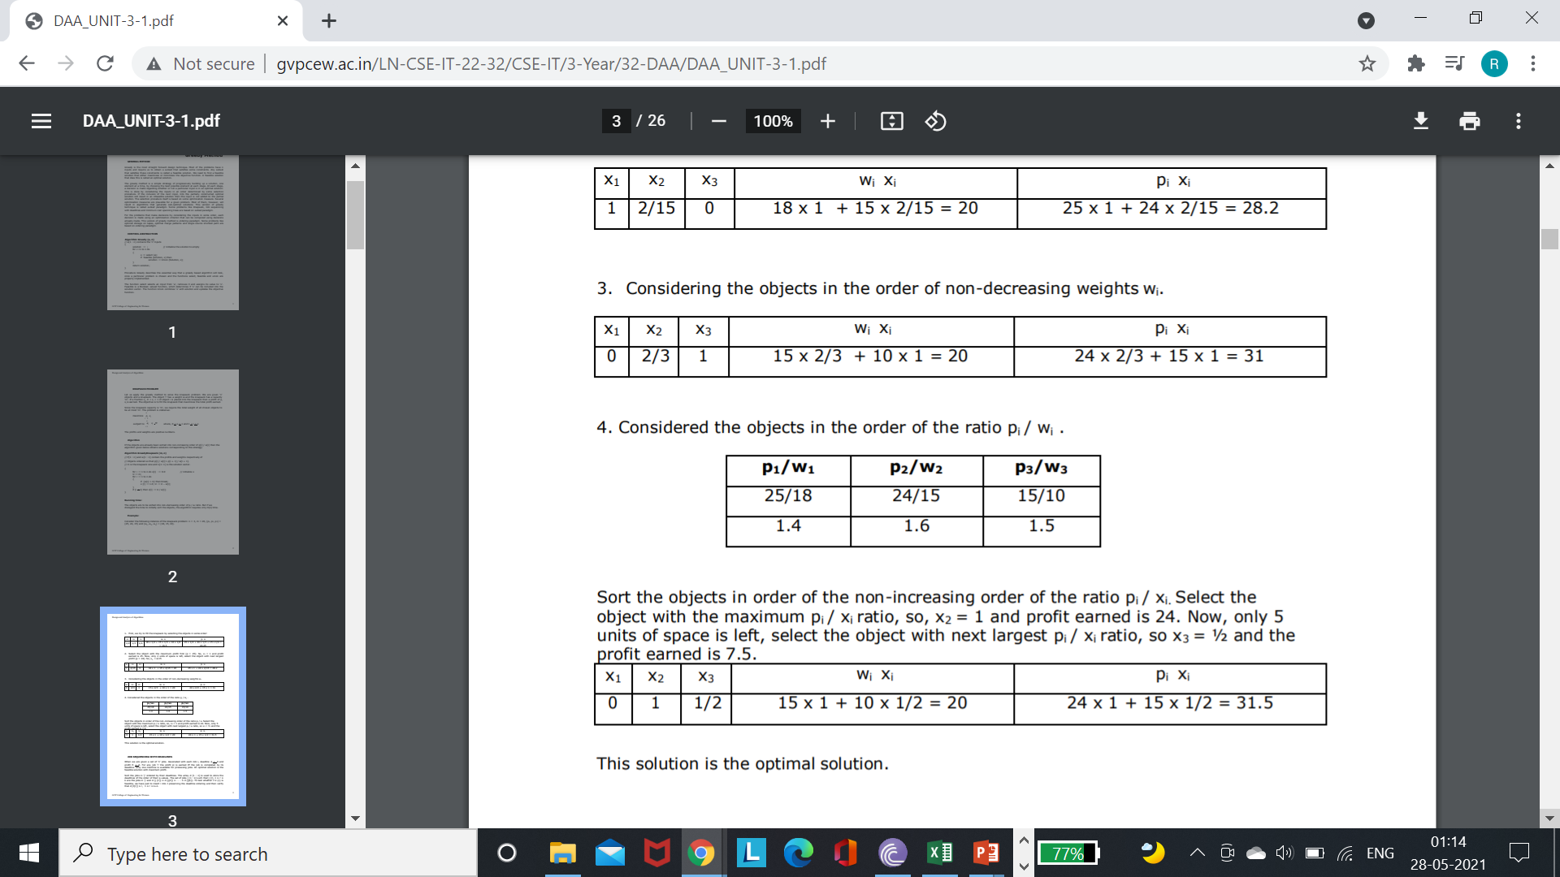

Slide 12
// number of denominations using greedy
#include<iostream>
using namespace std;
#define COINS 9
#define MAX 20
// All denominations of Indian Currency
int coins[COINS] = { 1, 2, 5, 10, 20,50, 100, 200, 2000 };
void findMin(int cost)
{
int coinList[MAX] = { 0 };
int i, k = 0;
for (i = COINS - 1; i >= 0; i--) {
while (cost >= coins[i]) {
cost -= coins[i];
// Add coin in the list
coinList[k++] = coins[i];
}
}
for (i = 0; i < k; i++) {
// Print
cout<<coinList[i]<<“ “;
}
return;
}
int main(void)
{
// input value
int n;
cin>>n;
findMin(n);
return 0;
}

Slide 13
Note: The above approach may not work for all denominations. For example, it doesn’t work for denominations {9, 6, 5, 1} and V = 11. The above approach would print 9, 1 and 1. But we can use 2 denominations 5 and 6. For general input, dynamic programming approach can be used:

